Slide 1
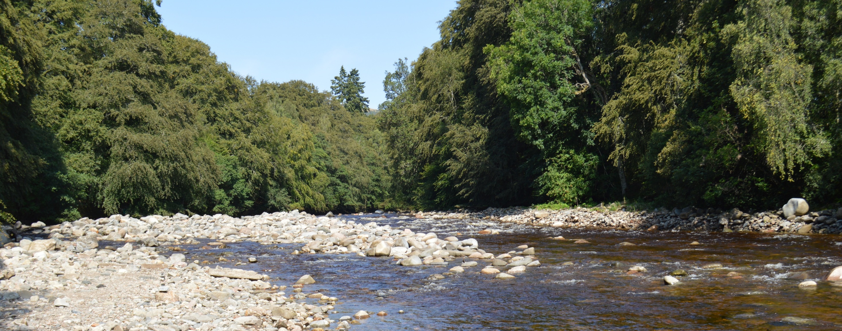
Rivers and Landscapes Pt2 Alex Lipp
Please send questions/feedback to: a.lipp18@imperial.ac.uk

Slide 2
Morning - Basic terminology of rivers + drainage - Key 'morphometrics’ - Basics of fluvial landscape evolution - Accessing fluvial data - Practical: Extracting + manipulating drainage models Afternoon: - What do rivers carry and what are their origins - What data do we measure from rivers - The problem of interpolating fluvial data - Practical: Tracking pollution sources through a drainage basin

Slide 3
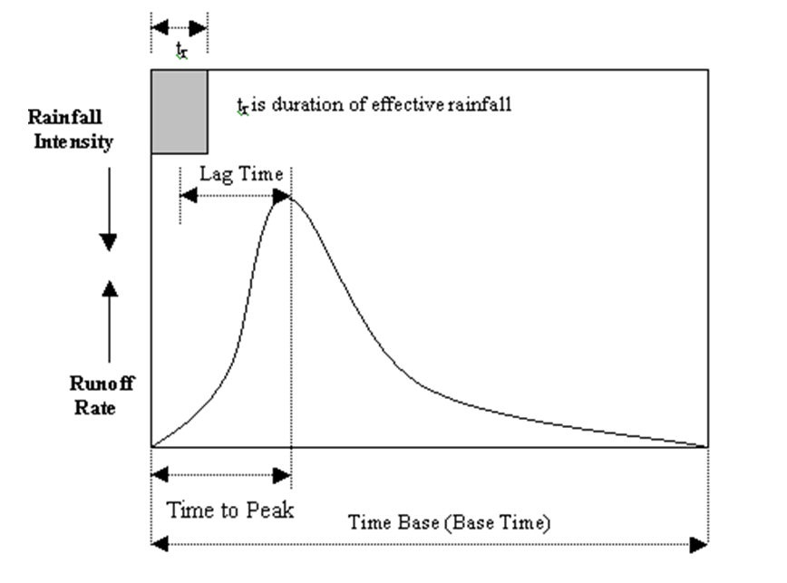
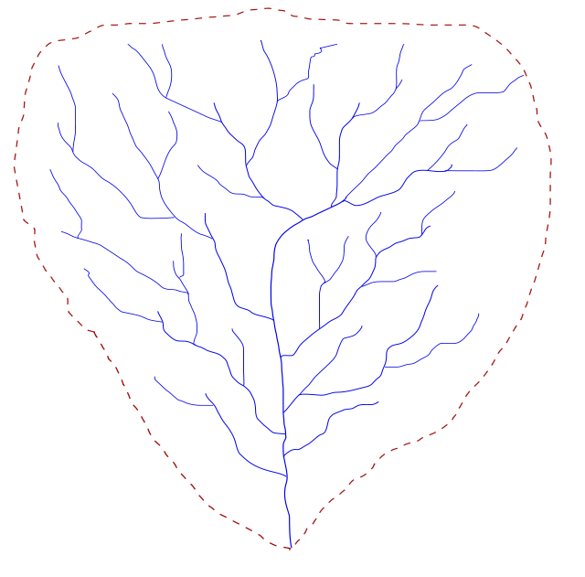
Discharge
Rising Limb
Recession/Falling Limb
Hydrology is a vast discipline!
The key metric is discharge and how it varies through time

Slide 4
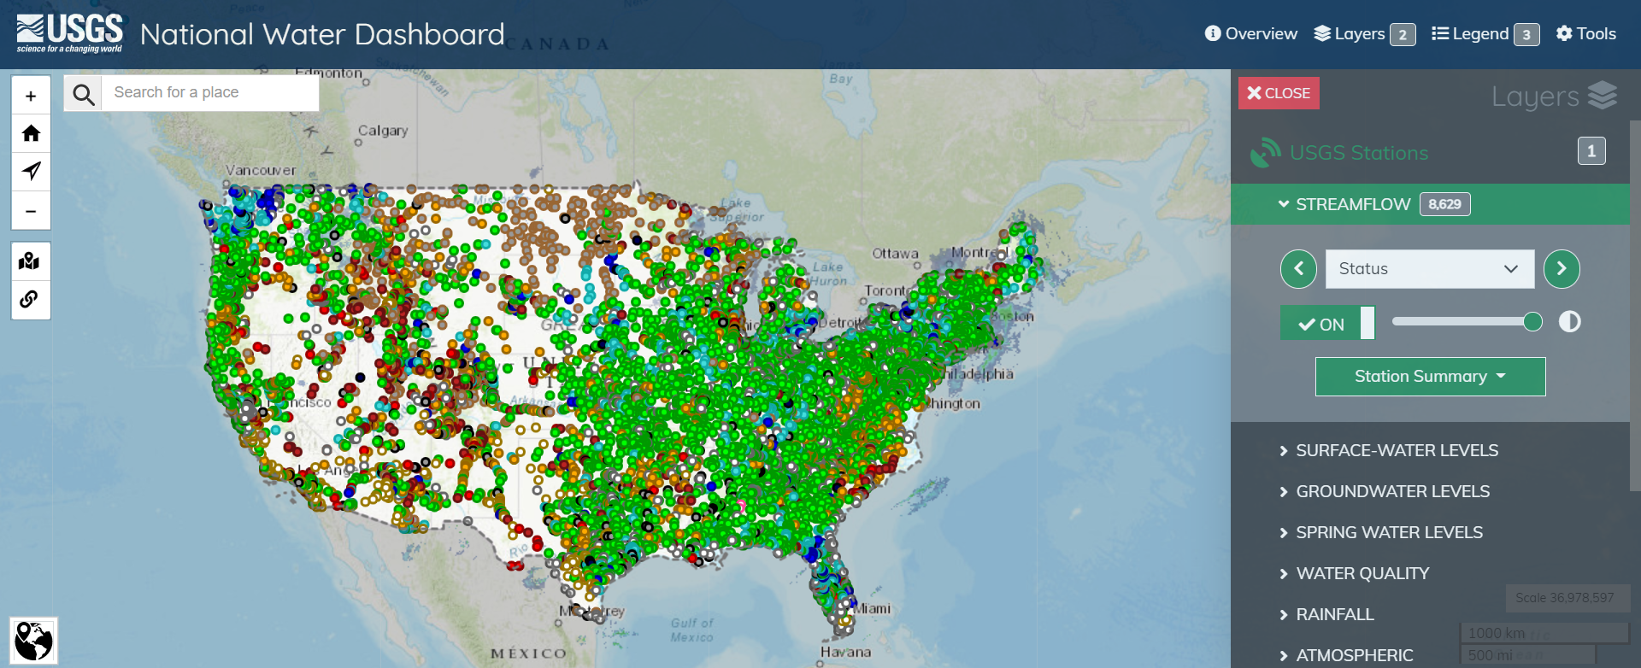
Hydrological data
Government data is often widely available
e.g. USGS Water Dashboard

Slide 5
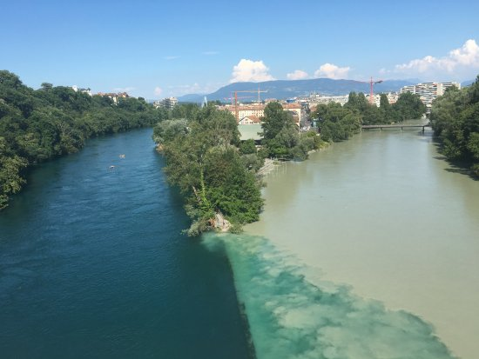
Frequently measured
pH
Turbidity (light scattering/penetration)
Essential nutrients (especially nitrates)
Major dissolved elements (Chlorine frequently)
Suspended sediment concentration

Slide 6
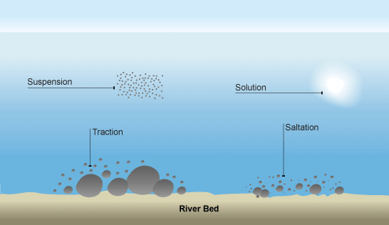

Slide 7
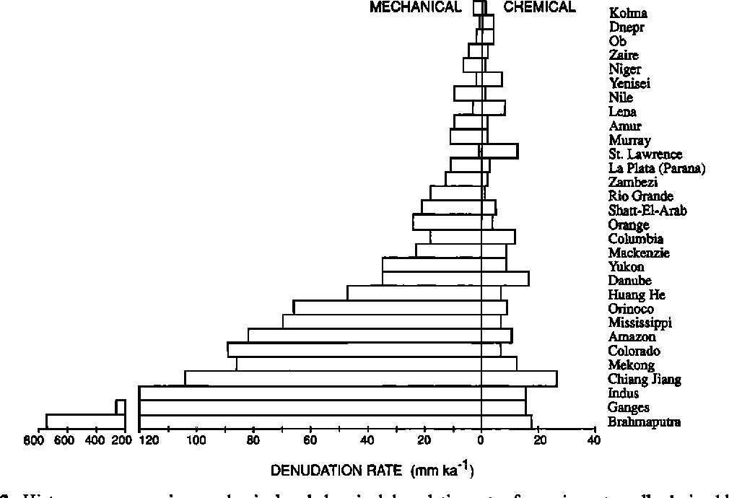
Physical sediment load of rivers dominates

Slide 8
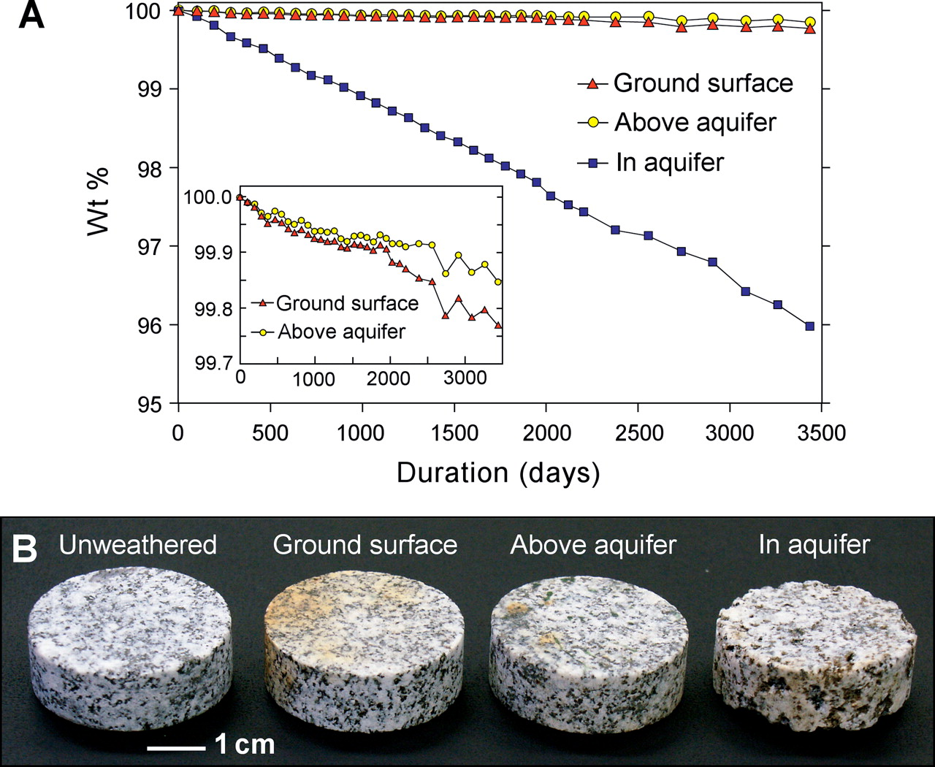
Chemical Weathering Reactions
Orthoclase Kaolinite
K AlSi₃O₈ + H⁺ + H₂O = Al₂Si₂O₅(OH)₅ + H₄SiO₄ + K⁺
Silicate + Acidity + H₂O = Clay + Silica + Cation
(Solid/Solute)
Silicate minerals formed at depth are unstable at Earth’s surface
React with slightly acidic water to form clay minerals and solutes
Some minerals (carbonates and evaporites) dissolve entirely (‘congruently’)

Slide 9
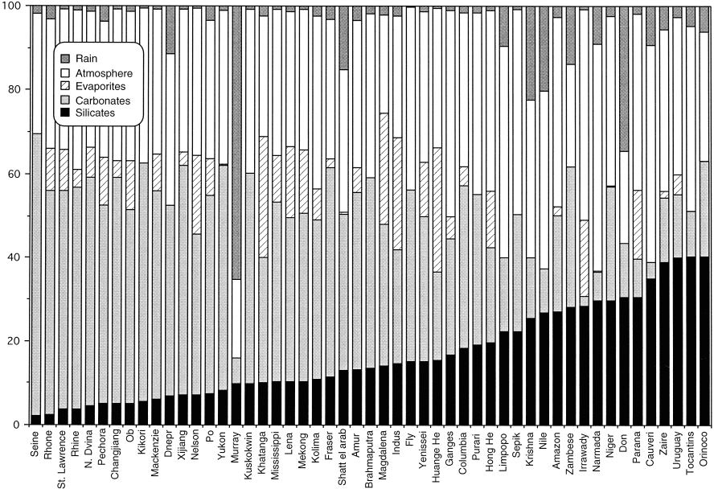
Where do solutes come from?

Slide 10
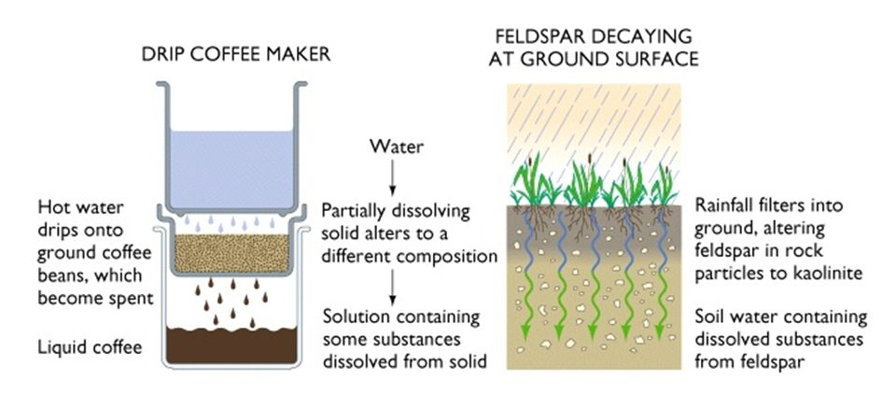
Coffee maker model of weathering
Fresh surfaces – More rock
More solvent – More water
Higher temperatures

Slide 11
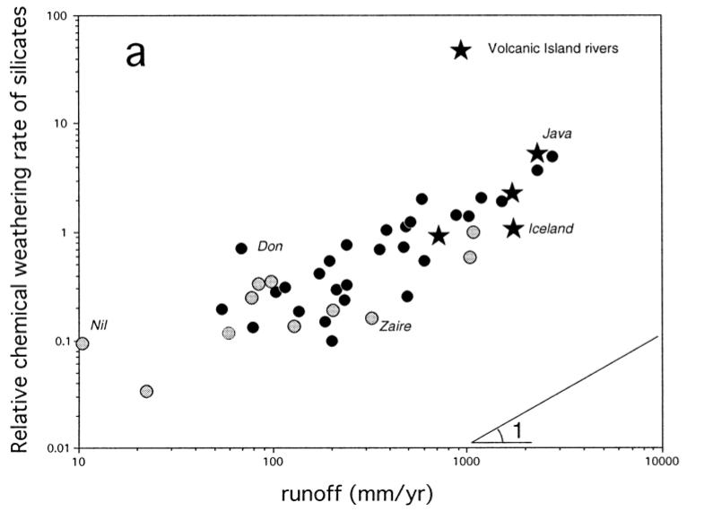
More solvent – More water
Fresh surfaces – More rock
Higher temperatures

Slide 12
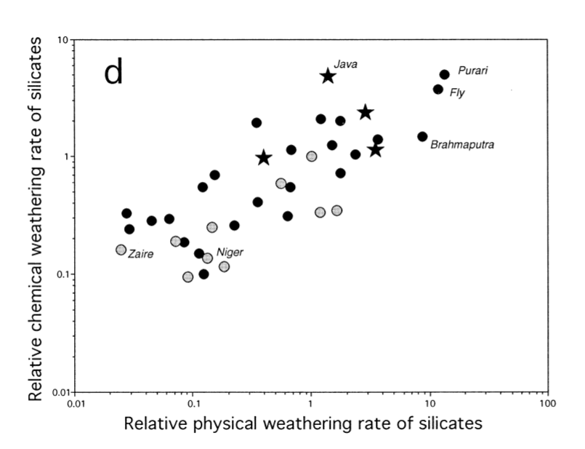
More solvent – More water
Fresh surfaces – More rock
Higher temperatures

Slide 13
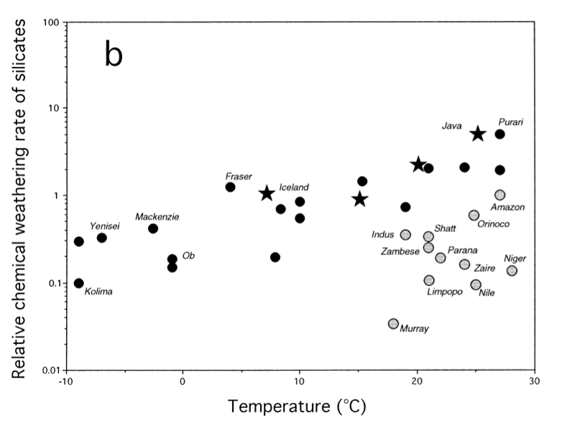
More solvent – More water
Fresh surfaces – More rock
?? Higher temperatures ??

Slide 14
More solvent – More water
Fresh surfaces – More rock
?? Higher temperatures ??

Slide 15
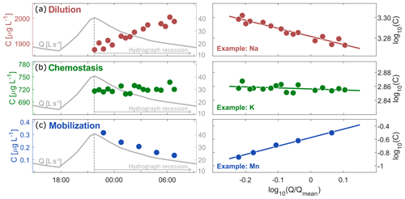
Concentration-Discharge analysis
Hydrogeochemical data in rivers frequently analysed using C-Q analysis

Slide 16
Sediment load
Orthoclase Kaolinite
K AlSi₃O₈ + H⁺ + H₂O = Al₂Si₂O₅(OH)₅ + H₄SiO₄ + K⁺
Silicate + Acidity + H₂O = Clay + Silica + Cation
(Solid/Solute)
The solid products of weathering reactions
Clay minerals + weathering resistant minerals (quartz), some primary
Bedload transported along the bottom
Suspended load within main water column
Total amount of sediment is controlled by the erosion rate

Slide 17
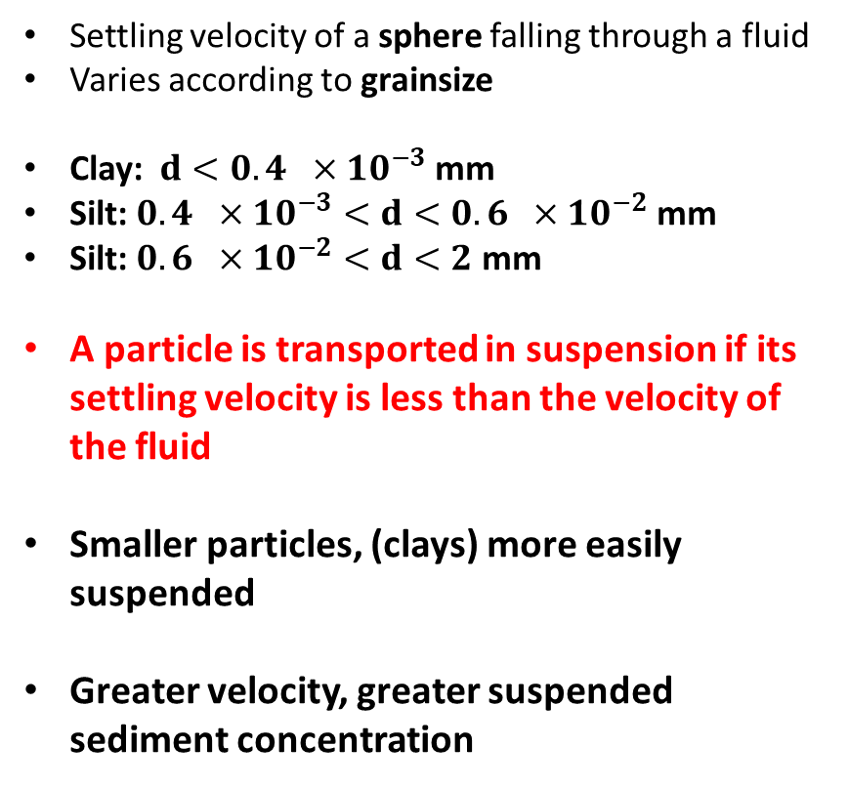
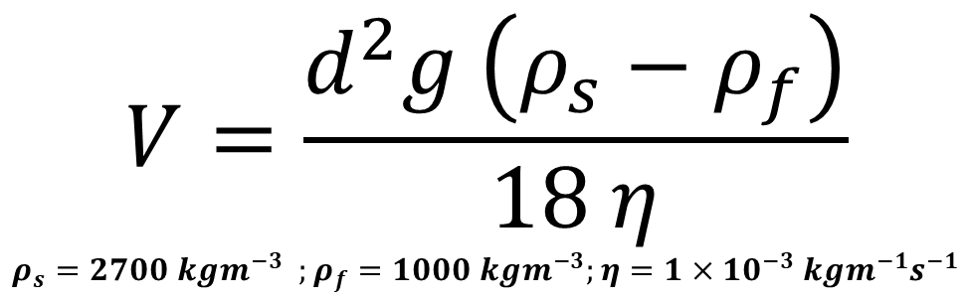
Stokes Law
Settling velocity of a sphere falling through a fluid
Varies according to grainsize
Clay: $d<0.4 ×10^{−3}$ mm
Silt: $0.4 ×10^{−3}<d<0.6 ×10^{−2}$ mm
Silt: $0.6 ×10^{−2}<d<2$ mm
A particle is transported in suspension if its settling velocity is less than the velocity of the fluid
Smaller particles, (clays) more easily suspended
Greater velocity, greater suspended sediment concentration
$$V=\frac{d^{2}g \left(ρ_{s}−ρ_{f}\right)}{18 η}$$
$$ρ_{s}=2700 kgm^{−3} ;ρ_{f}=1000 kgm^{−3};η=1×10^{−3} kgm^{−1}s^{−1}$$

Slide 18
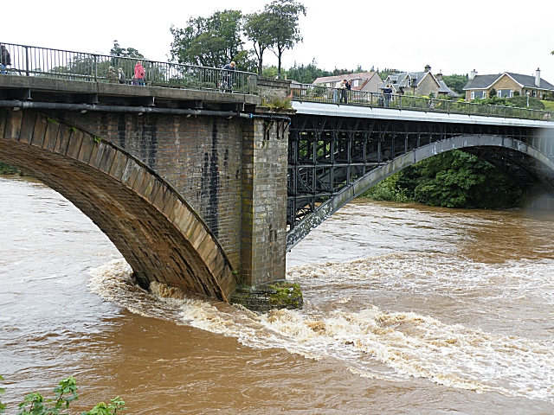
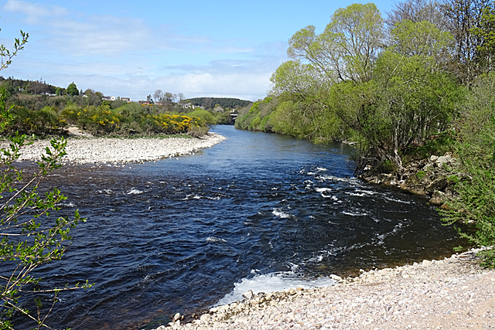
High-flow (“Spate”)
Normal flow

Slide 19
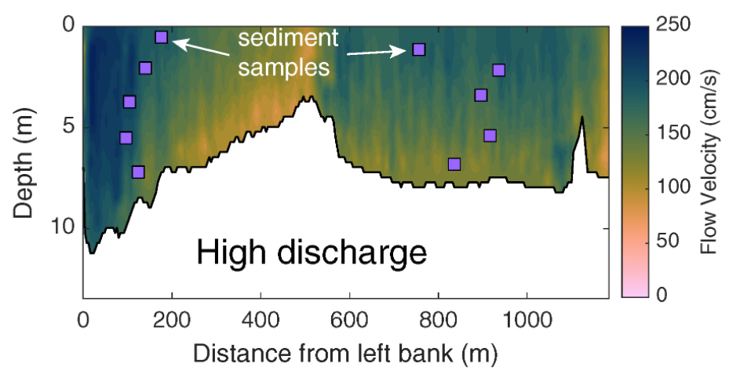
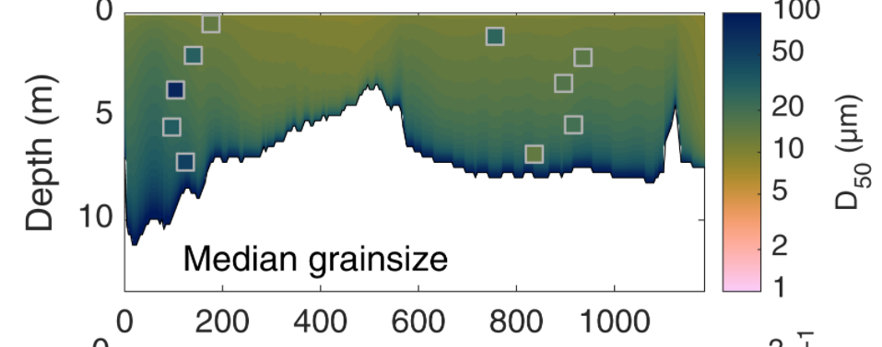
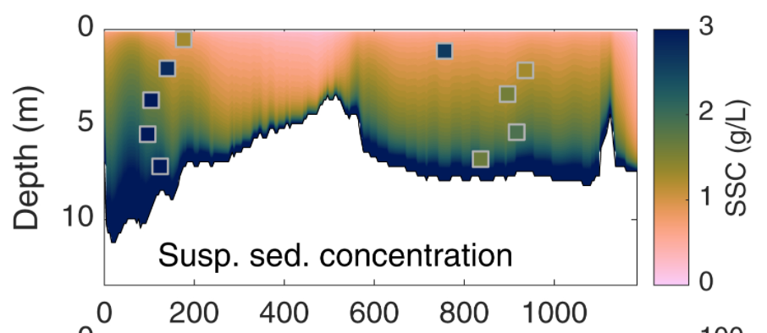
Flow velocity & sediment concentration varies across a river channel
Coarser sediment in greater concentration at depth

Slide 20
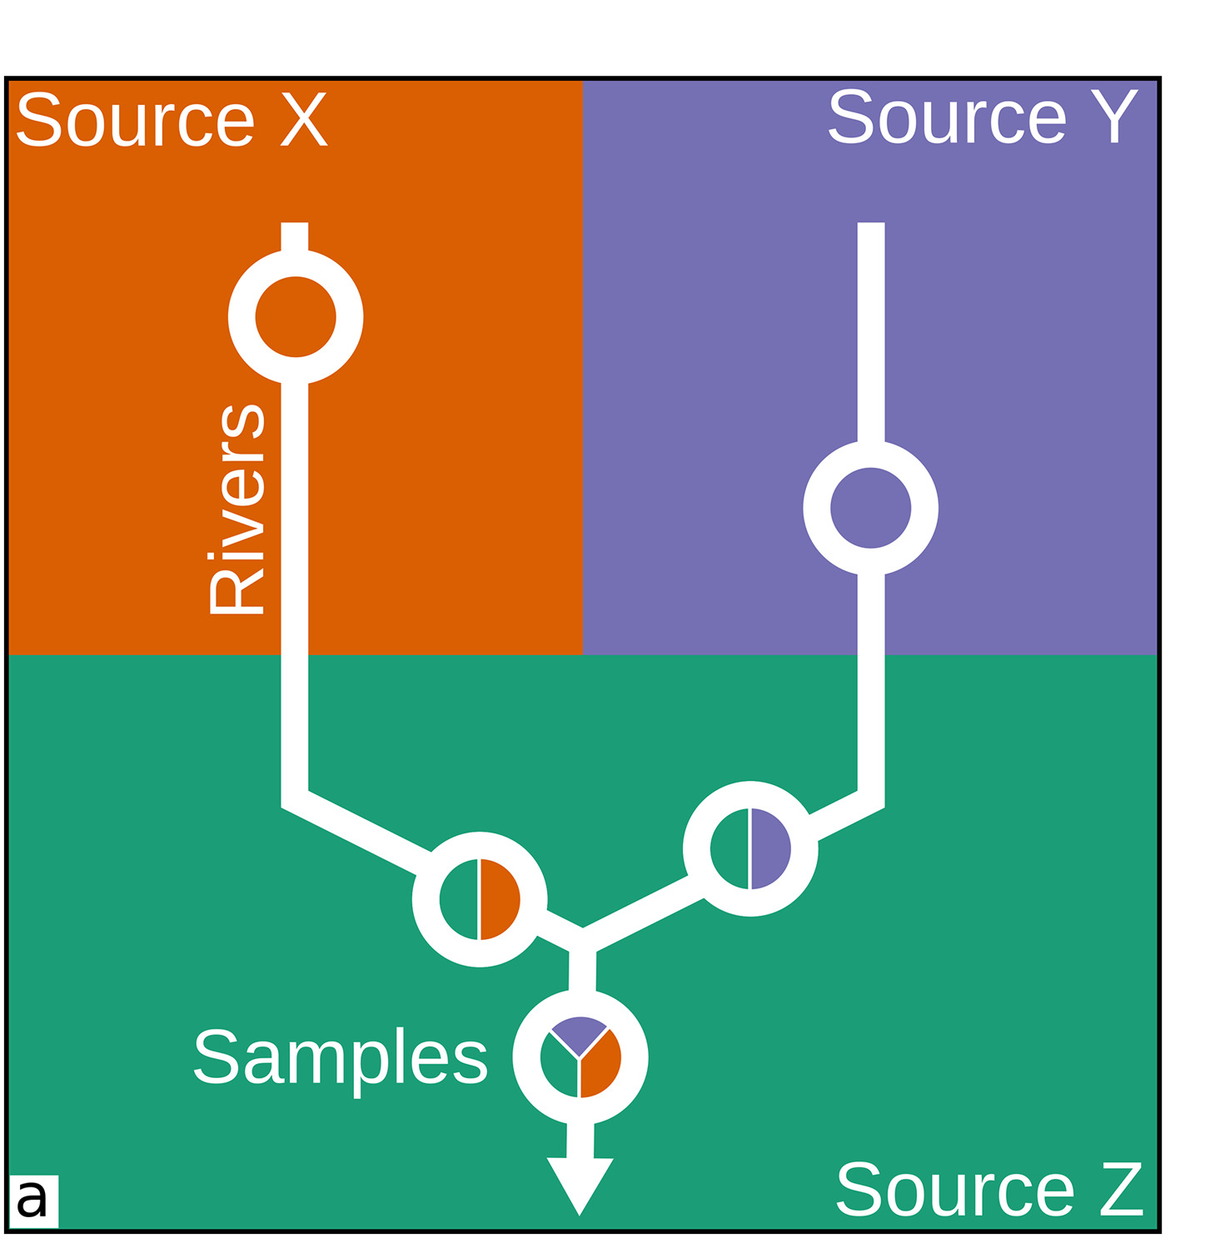
Sediment geochemistry
Geochemical composition of river sediment is a mixture of their source regions
Large rivers approximate the composition of the upper crust
But with ‘mobile’ cations removed by weathering
Beware the local affects of sorting

Slide 21
Cation-exchange
Ca²⁺
Ca²⁺
Clay Particle
Na⁺
Cations
Ca²⁺
- - - -
Na⁺
Ca²⁺
Ca²⁺
Na⁺
Na⁺
Na⁺
Dissolve cations adsorb onto the negative surface of platy-clay minerals

Slide 22
Freshwater
(high Ca/low Na)
Seawater
(low Ca/high Na)
Ca²⁺
Na⁺
When solute changes (i.e. freshwater -> seawater) different cations desorb and adsorb
Most common reaction, adsorbed ‘freshwater’ calcium is exchanged for ‘seawater’ sodium
Charge balance is maintained

Slide 23
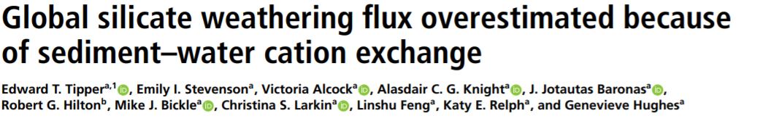
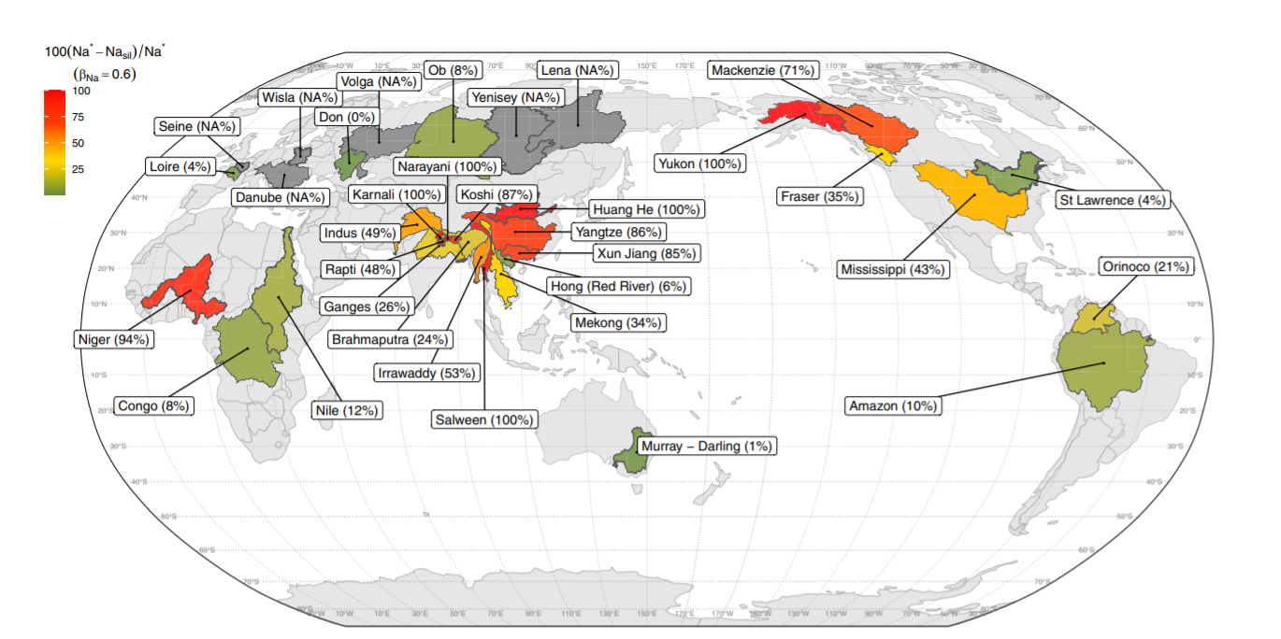
A second order effect, but important to take into consideration

Slide 24
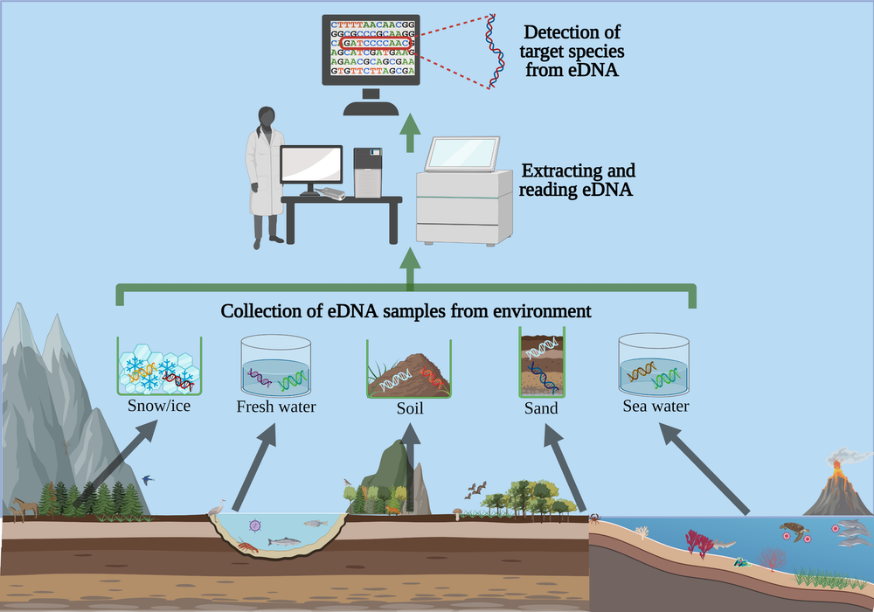
Environmental DNA (eDNA)
Organisms shed DNA into their aquatic environment
This can be detected in samples
Hence, presence of a species can be monitored without time-consuming/challenging real-term observation
Aquatic eDNA lasts up to 21 days

Slide 25
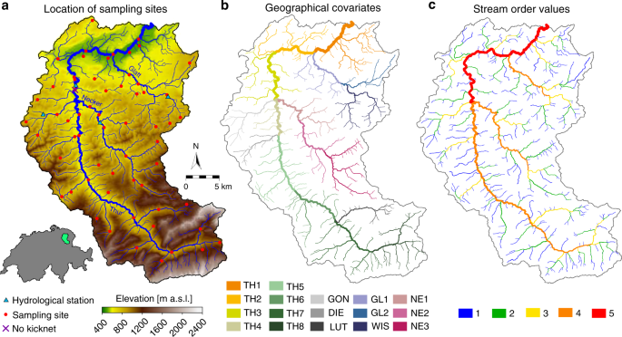
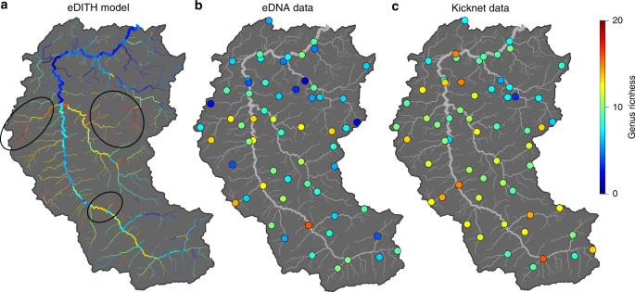
Fluvial eDNA
Genus Richness
Downstream eDNA is a mixture of upstream species distributions

Slide 26
The problem of fluvial point-data
Consider samples of any data along a drainage network
eDNA, hydrogeochemistry, sediment geochemistry
What is the appropriate way to extrapolate between those points?

Slide 27
The problem of fluvial point-data
Need to consider stream-line based approaches
The topology of the drainage network is fundamental
Most fluvial data is a downstream mixture
Geographical distance
Topological distance

Slide 28
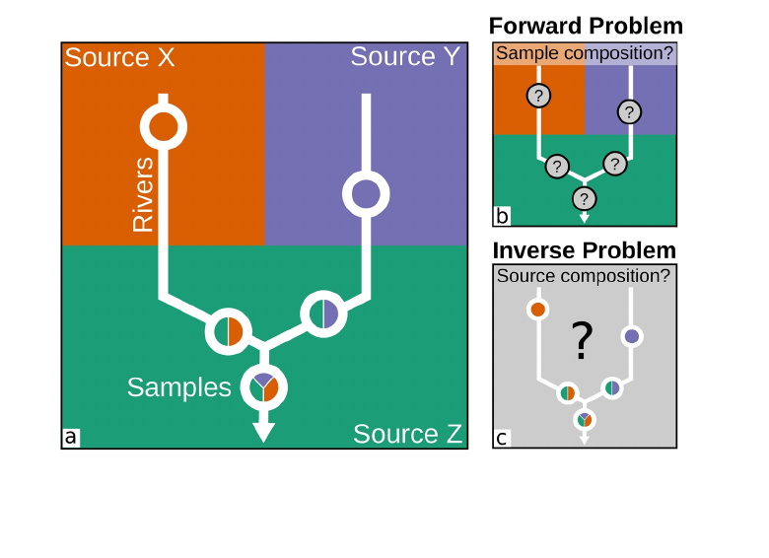
Unmixing
Current research problem is how to ‘unmix’ fluvial point data to get at best fitting model of the drainage
‘Under-determined’ problem solved using inverse techniques

Slide 29
Outputs
Inputs

Slide 30
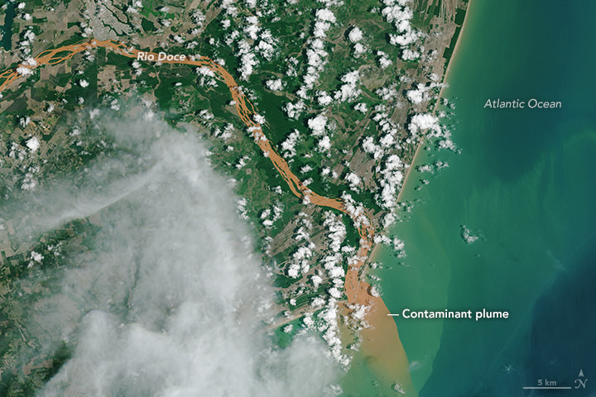
Practical
What happens if you release a large amount of toxic pollutant upstream…

Slide 31
Key Takeaways
A range of hydrogeochemical data is readily available for analysis often in realtime
Rivers transport dissolved ions produced by weathering
The solid weathering products are transported as sediments, sorted by grainsize
Rivers increasingly analysed for environmental DNA
Interpolating point data gathered on rivers must be done considering drainage network topology
Further reading
See also citations on individual slides…
Data sources
USGS Water Dashboard [Have an explore, see what's available]
Textbooks
“Geomorphology: The Mechanics & Chemistry of Landscapes” Anderson & Anderson; pp183-202.
“River Discharge to the Coastal Ocean – A Global Synthesis” Milliman & Farnsworth [Read sections with extreme selectivity! The go-to data source on what rivers transport]
Some papers
“Global silicate weathering and CO2 consumption rates deduced from the chemistry of large rivers” Gaillardet et al. 1999 [The classic analysis of what controls global geochemistry in rivers]
“Environmental DNA allows upscaling spatial patterns of biodiversity in freshwater ecosystems” Carraro et al. 2018

